Slide 1
PLACEMENT SKILLS ASSESSMENT SYSTEM AND BENCHMARKING
Students:
Arpana.S 15ITA02 (IV B.Tech IT)
Himanshu Jain.P 15ITA08 (IV B.Tech IT)
Vallikannu.A.R 15ITA33 (IV B.Tech IT)
Project Guide:
Dr.G Vijaya, Head of the Department, Information Technology

Slide 2
Problem Statement
Existing Placement Online Assessment Training will not provide the analysis report of the student in an individual basis. Successful training program are well aware of the assessments that are vital part of improving aptitude skills, knowledge and their courage to face the interview. But there is no provision to train the students where they want to be trained in the specific field.
The proposed system provides the analysis report on students who takes the test and provides the high quality tests with varied difficulty levels based on the score obtained.

Slide 3
Abstract
This project is built to enhance the students assessment and train them for their placements. The system provides an initial test that is called a mandatory test to all students of various departments during their beginner stage. Based upon the outcome, the system will generate an individual student report, where each and every student data will be analyzed and their benchmarks will be highlighted. Furthermore, test levels will be generated based upon their previous performance and questions will be randomly distributed for each student based upon their performance. The student can attempt the test multiple times to improve his/ her placement skills. The attempts made by the students and related scores will be updated to the respective faculty members and to the students.
Keywords: Placement, Assess student, Analyse

Slide 4
Literature Survey
Placement Test Web Portal
Author name:Anand Singh[1],Aishwary Shukla[2],Maulik Sharma[3],Rahul Yadav[4
Published On:2017
This paper specifies automation of manual procedures such as conduction of tests, displaying results, and notifying the results to students via email. They focus on the automation of placement related tests conducted by the placement cell of an Institute.
College Placement Portal
Author name:Swapnil Gholap
Published On:2017
This paper collects all student data and provides it to admin(Placement officer). The admin then processes this data to identify eligible students. Also, their system conducts regular tests to check the eligibility of students. Based upon their scores, eligibility is defined.

Slide 5
Literature Survey(Contd)
Training and Placement Web Portal:
Author name:Mr.Hitesh K Kasture
Published On:2014
This paper also deals with automating the placement related test process by automating it. They concentrate on bringing accuracy to the test result. Their idea is to reduce paperwork and storage space and provide user-friendly interface.

Slide 6
Modules
Student Modules
Register
Login Module
Student Dashboard
Report
View result

Slide 7
Modules (contd)
Faculty Modules
Register
Login Module
Dashboard
Upload question
View report

Slide 8
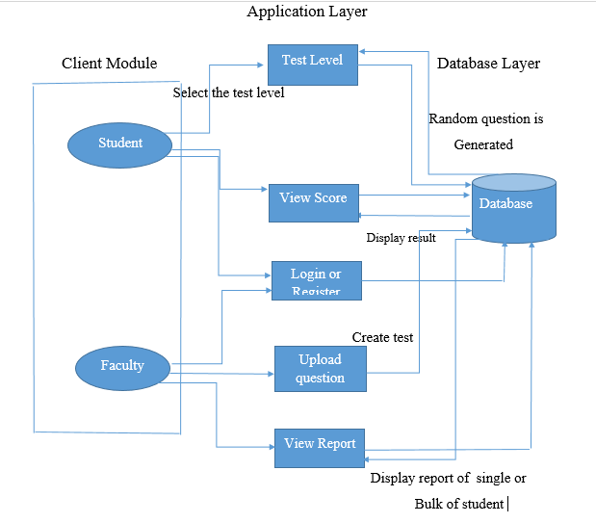
Architecture Diagram

Slide 9
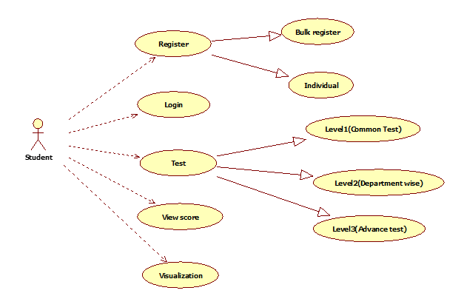
Usecase Diagram: Student

Slide 10
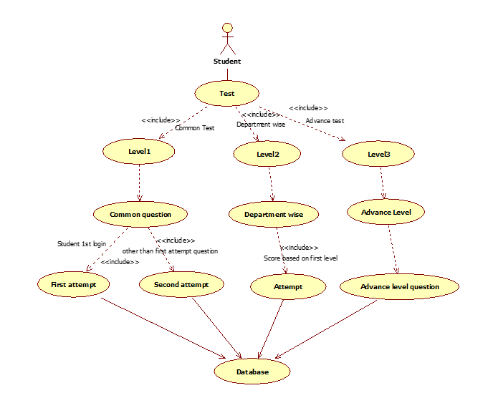
Usecase Diagram: Randomization

Slide 11
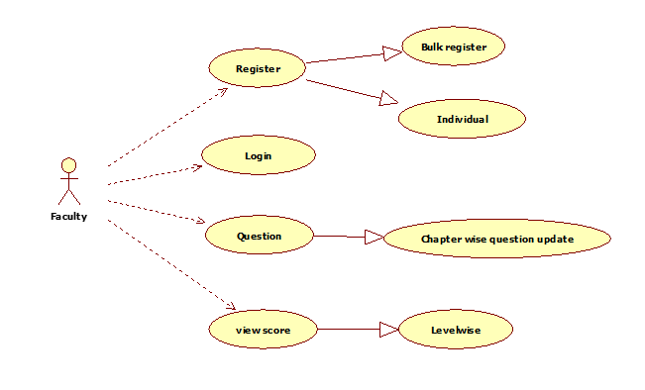
Usecase Diagram: Faculty Module

Slide 12
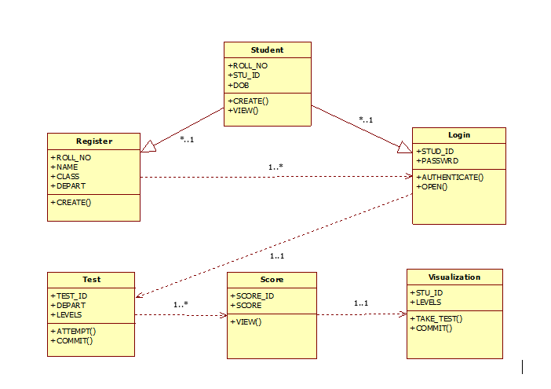
Class Diagram: Student

Slide 13
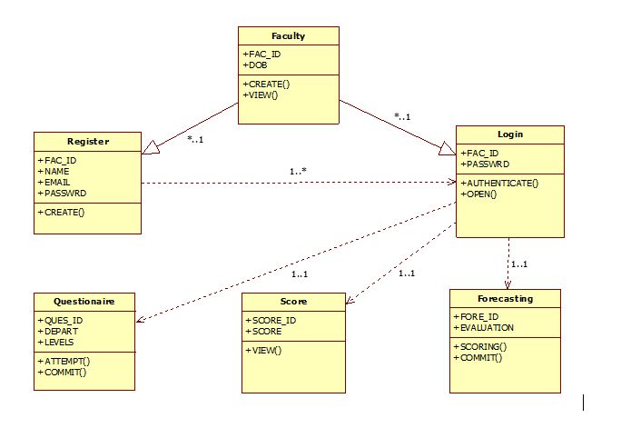
Class Diagram: Faculty

Slide 14
Requirement analysis for each module
Student Module:
Web Browser
Faculty Module:
Web Browser
Other Requirement:
Oracle Server

Slide 15
Module Description
Student Module
Faculty Module

Slide 16
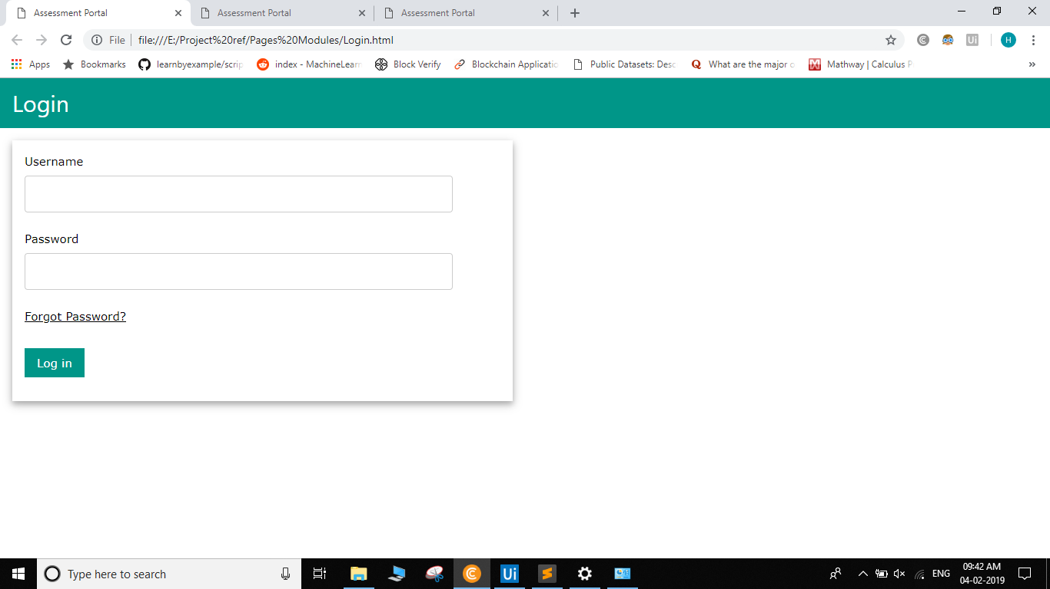
User Interface (Login)

Slide 17
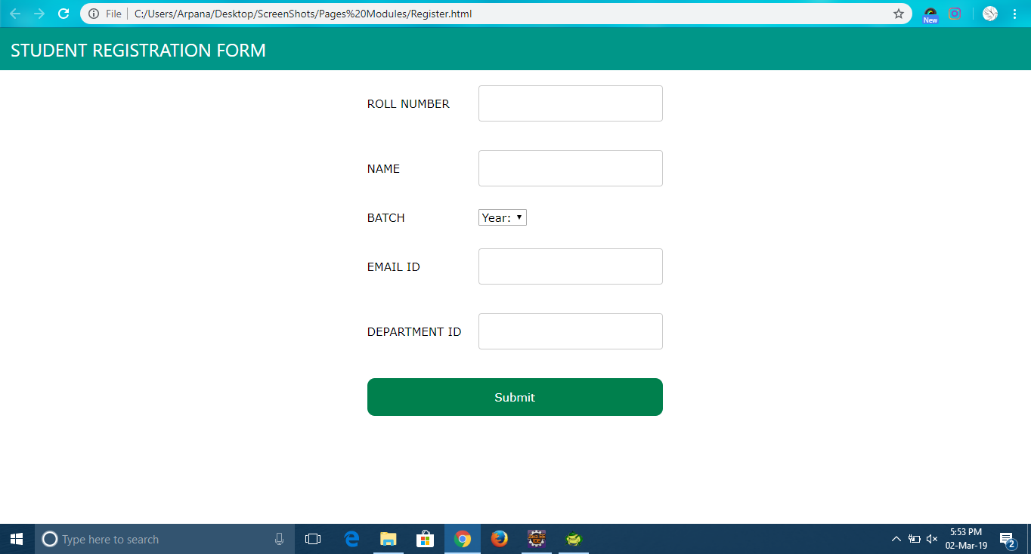
Registration

Slide 18
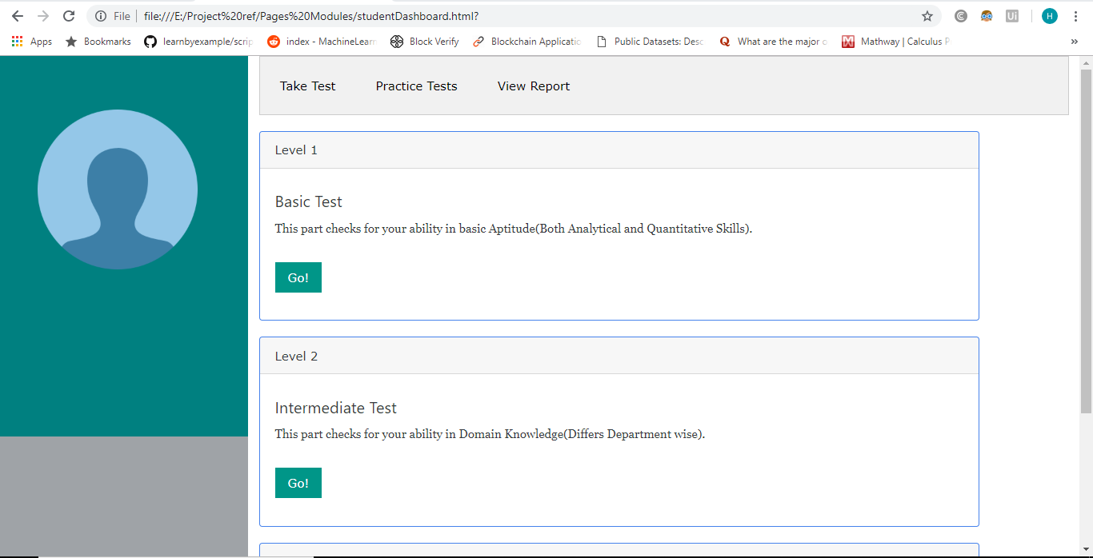
Student Module(Dashboard)

Slide 19
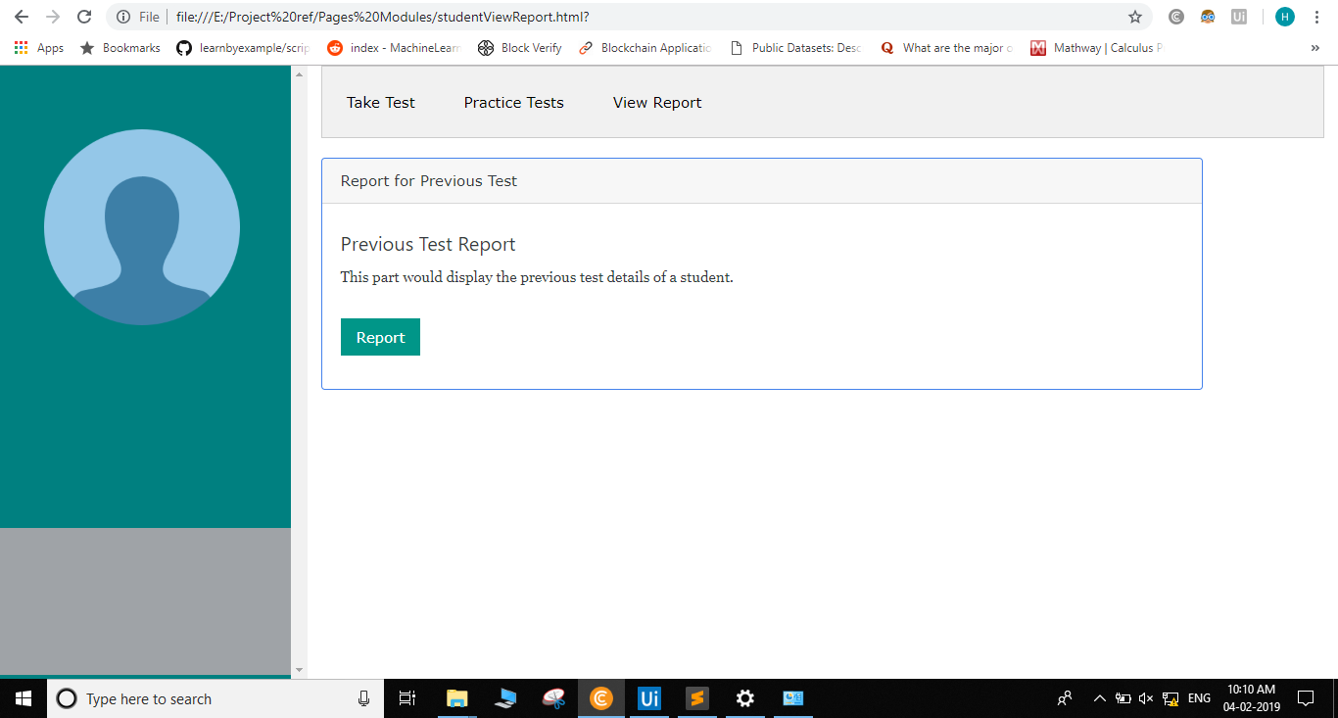
Student report

Slide 20
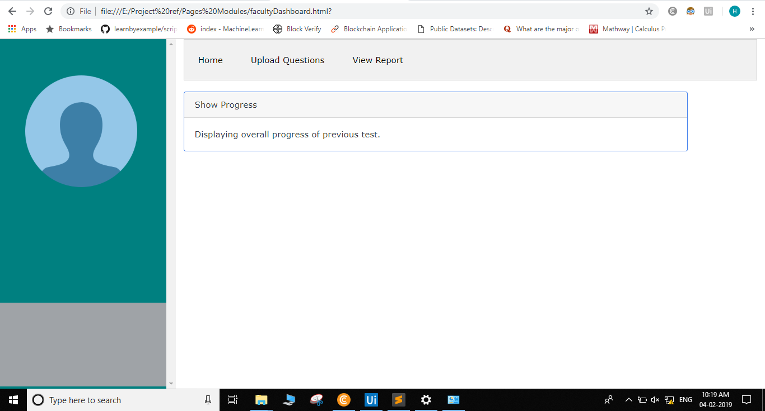
Faculty Dashboard

Slide 21
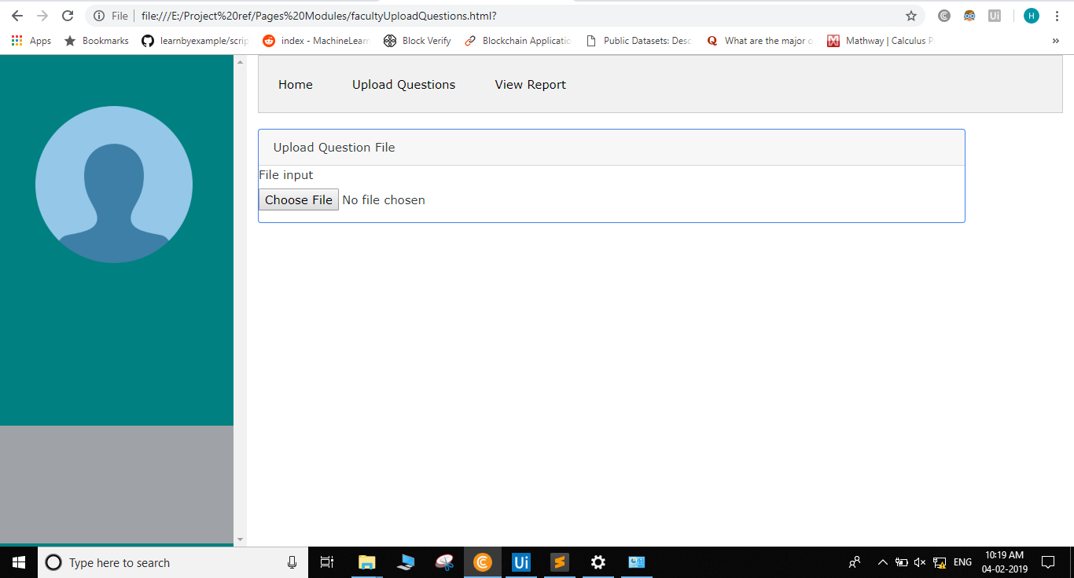
Faculty(Upload question)

Slide 22
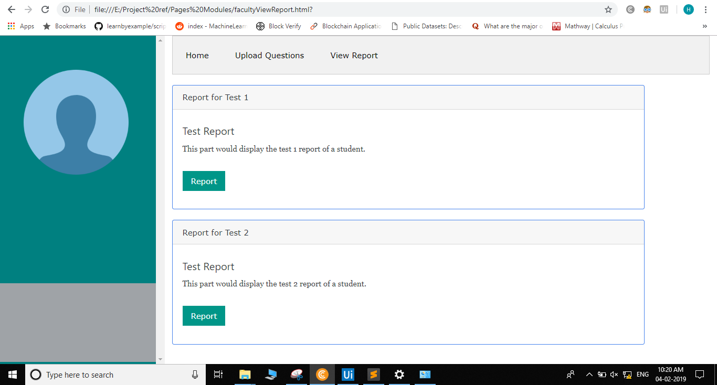
Faculty(View Report)

Slide 23
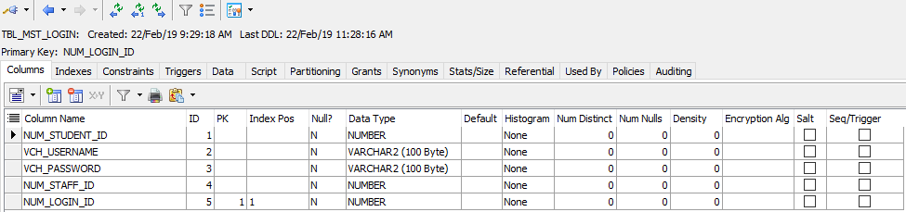
Database (Table design) Login

Slide 24
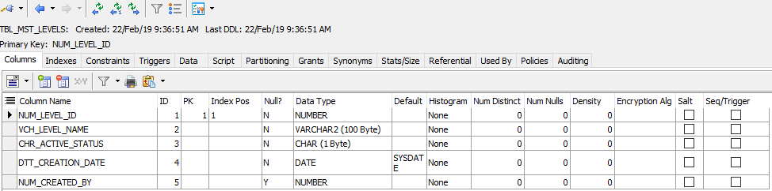
Level Table

Slide 25
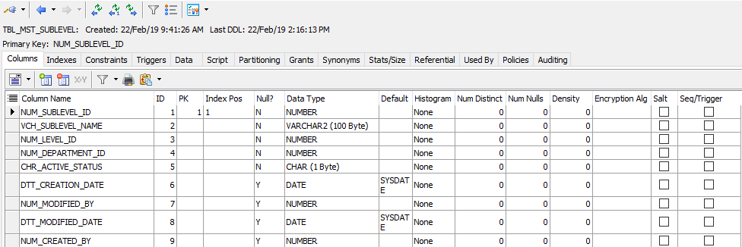
SubLevel Table

Slide 26
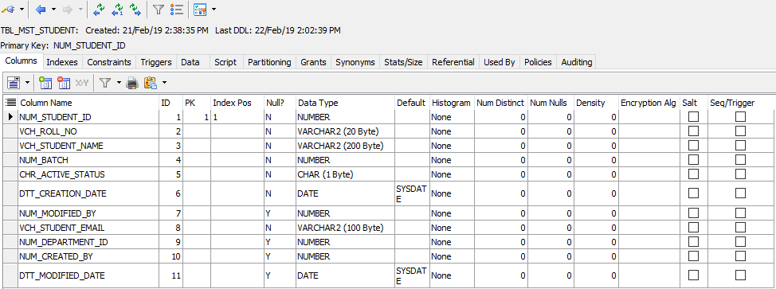
Student Table

Slide 27
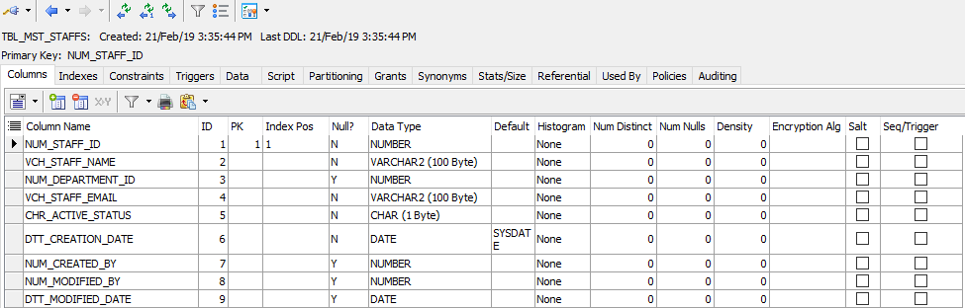
Staff Table

Slide 28
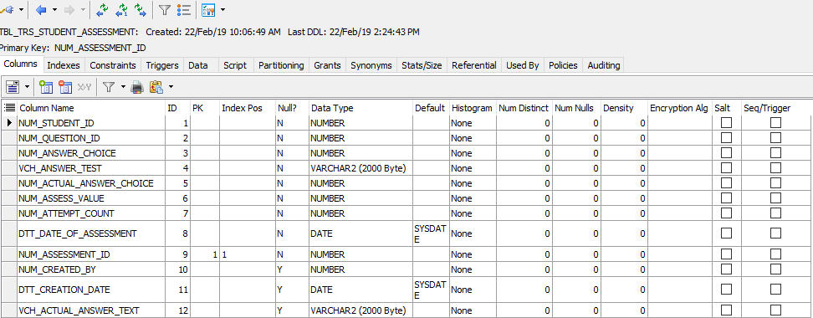
Student Assessment System

Slide 29
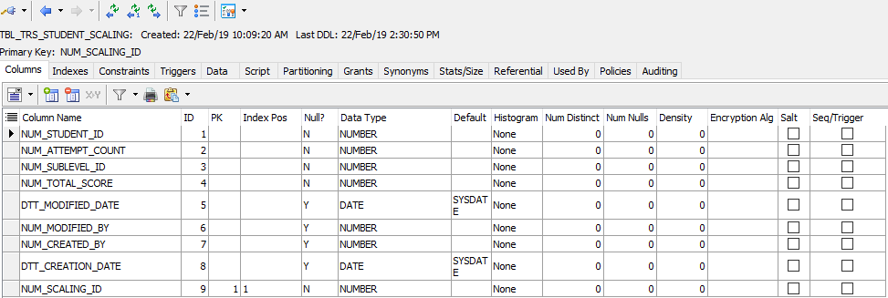
Scaling Parameter

Slide 30
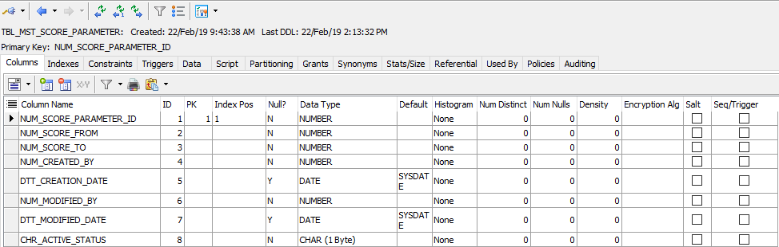
Score Parameter

Slide 31
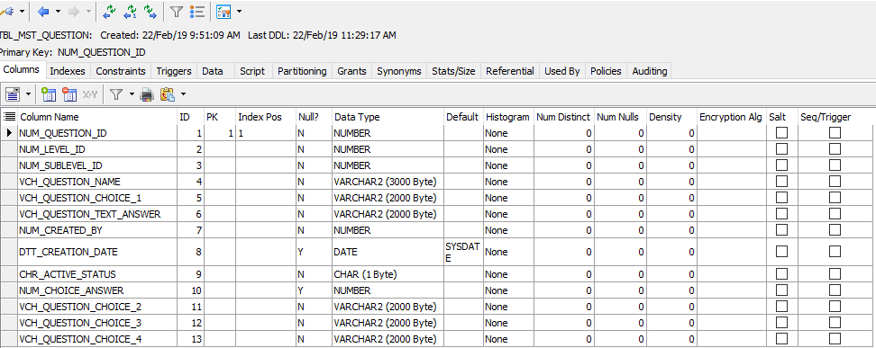
Question Table

Slide 32
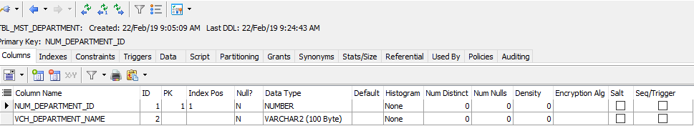
Department

Slide 33
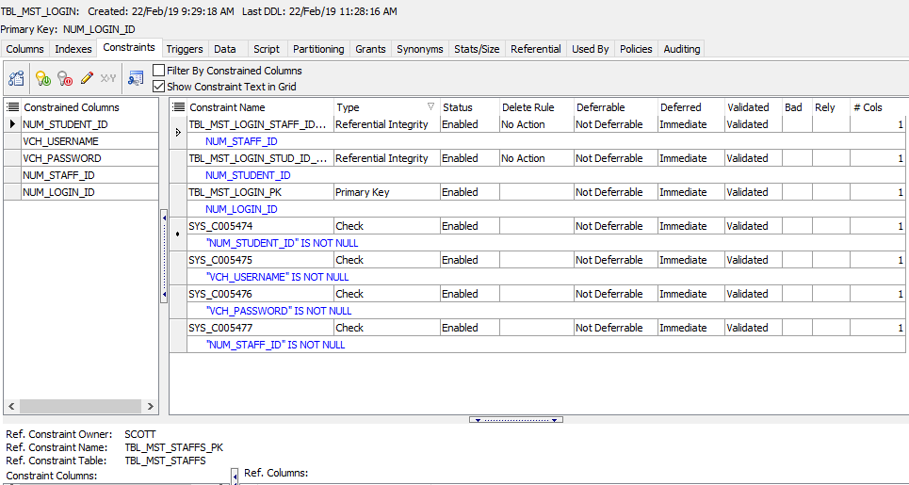
Primary and Foreign Key(Login)

Slide 34
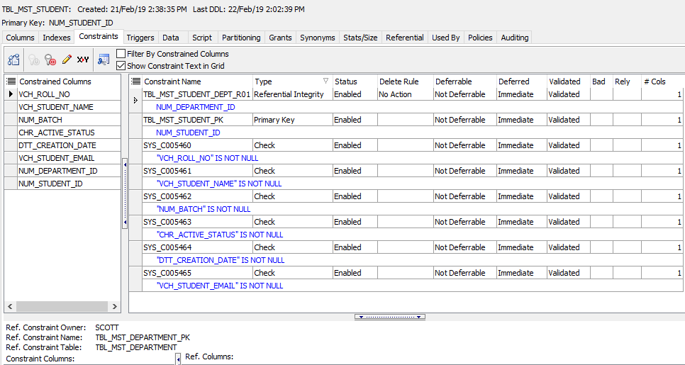
Student

Slide 35
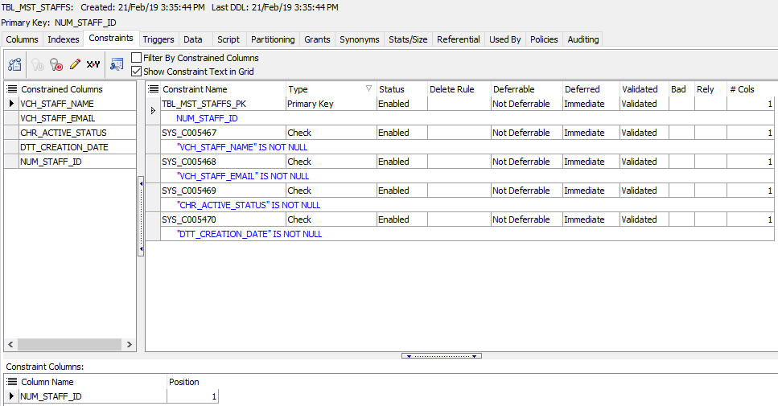
Staff

Slide 36
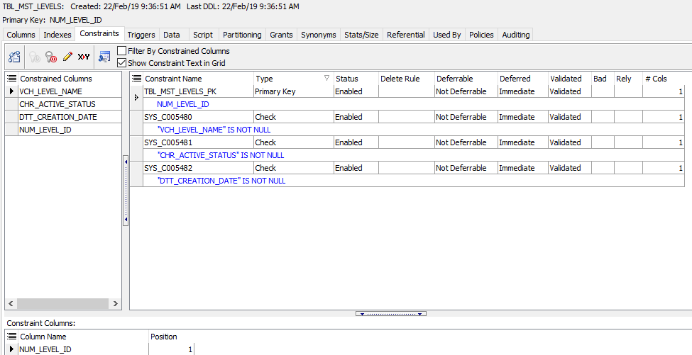
Level

Slide 37
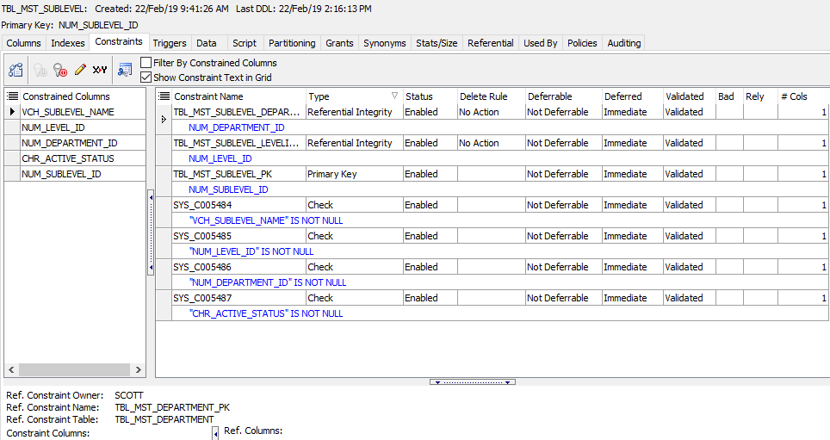
SubLevels

Slide 38
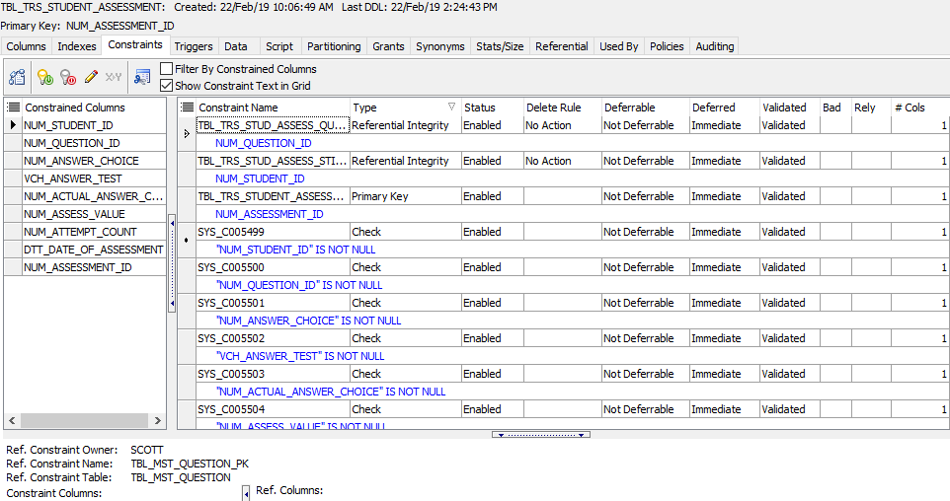
Assessment Data

Slide 39
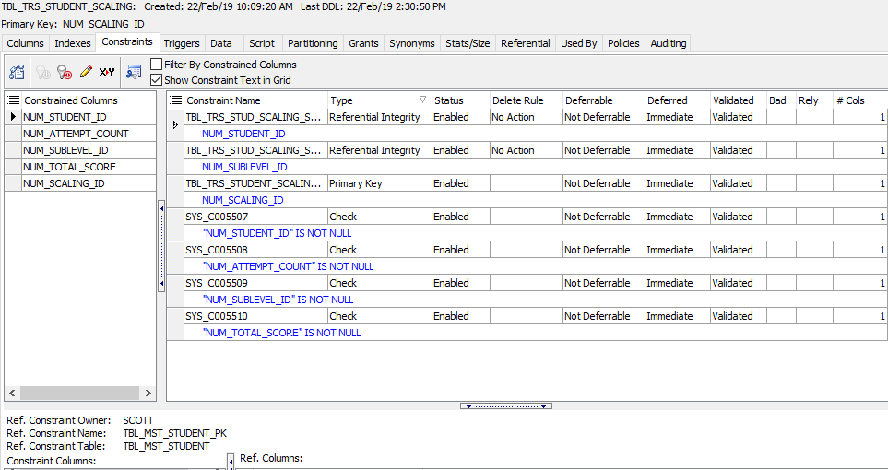
Scaling Data

Slide 40
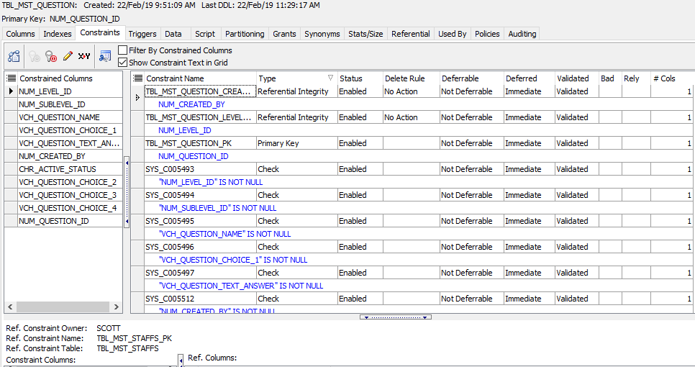
Question

Slide 41
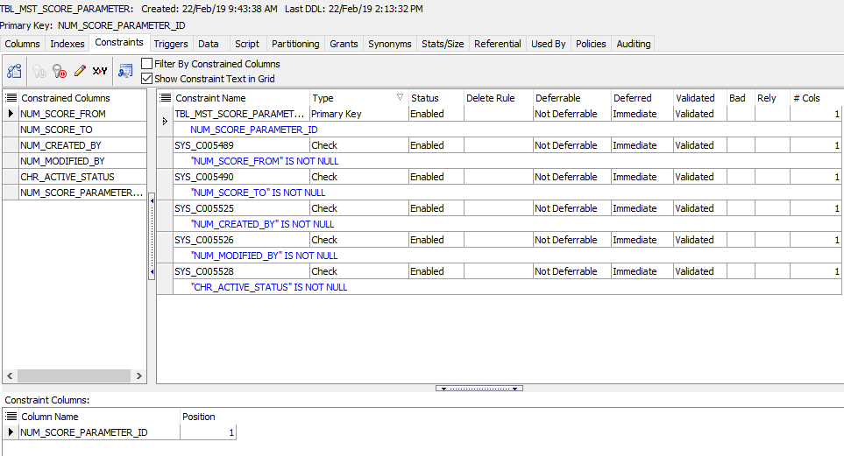
Score Parameter

Slide 42
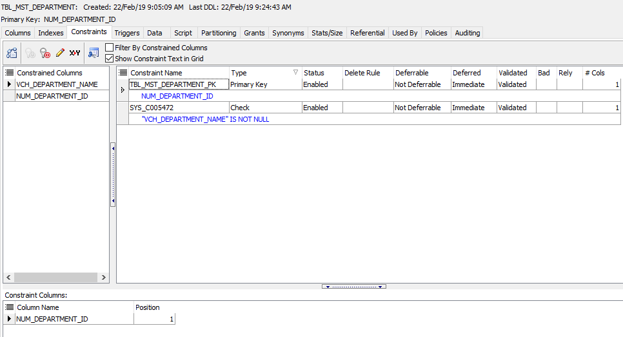
Department

Slide 43
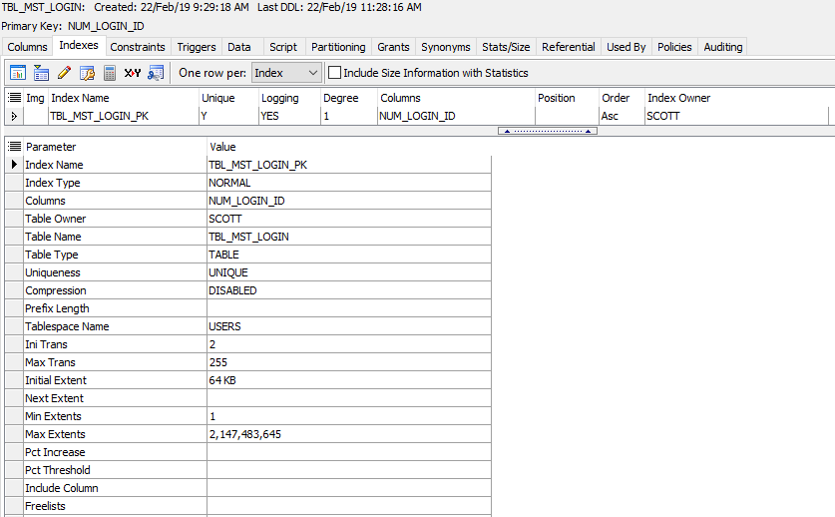
Normalized Table(Login)

Slide 44
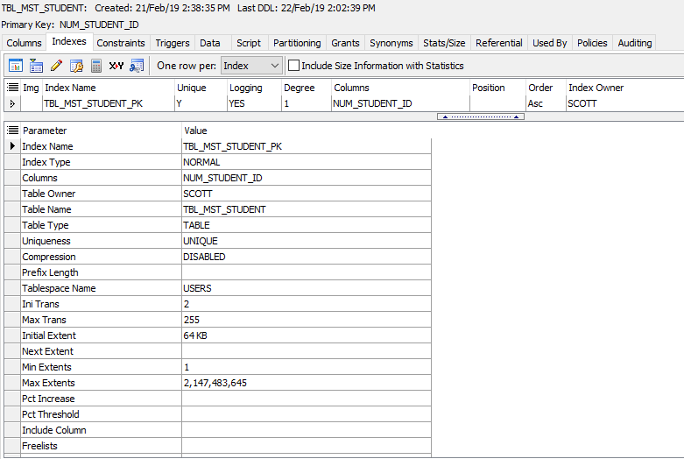
Student

Slide 45
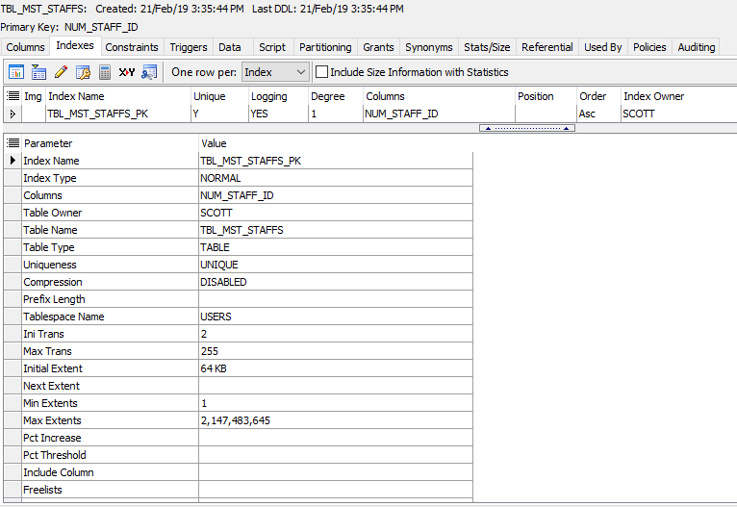
Staff

Slide 46
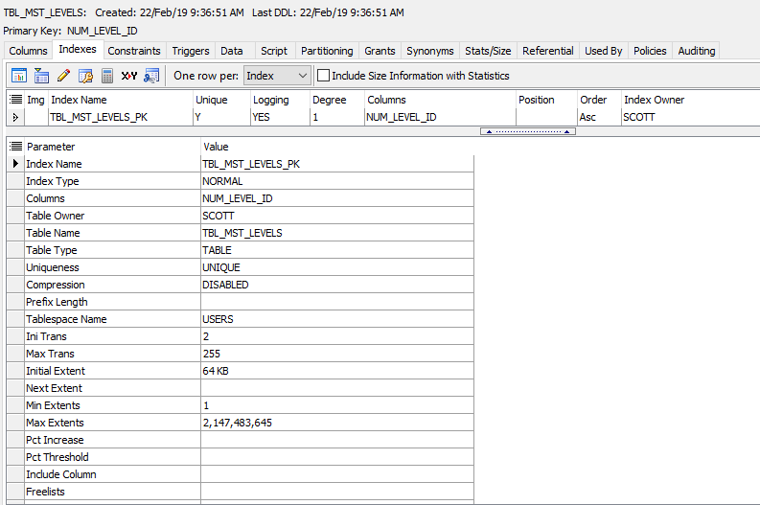
Levels

Slide 47
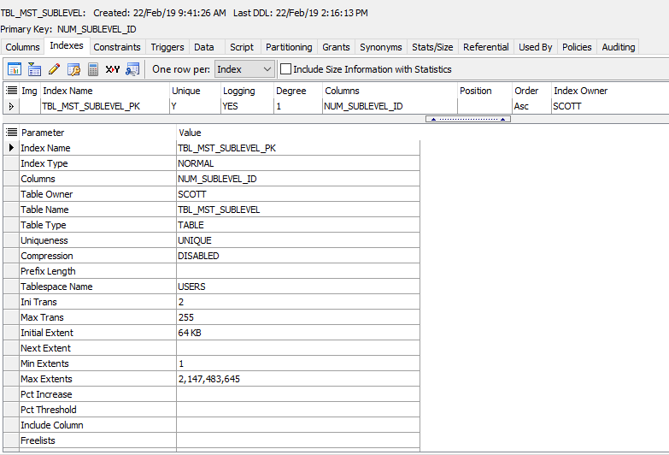
SubLevels

Slide 48
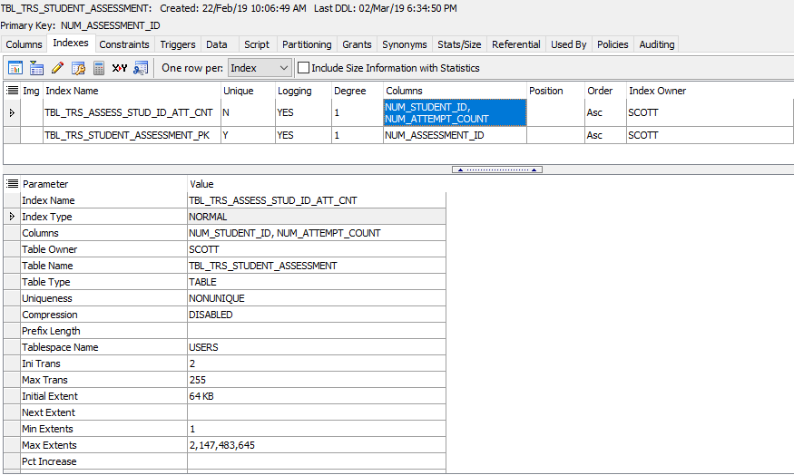
Assessment-Normalized Table

Slide 49
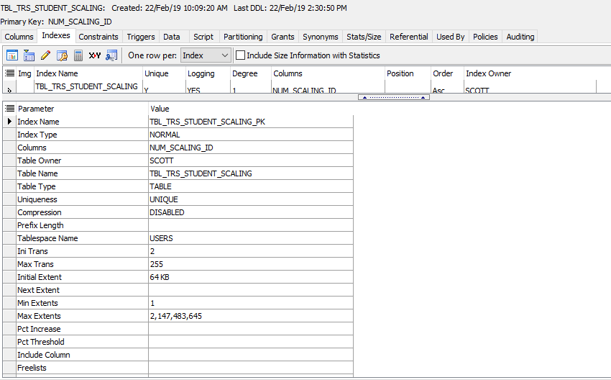
Scaling

Slide 50
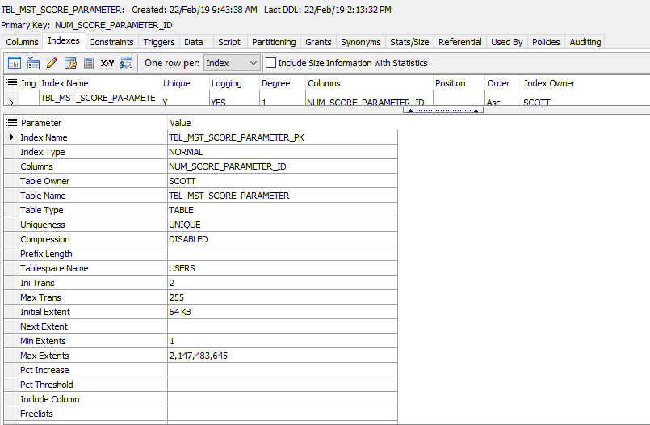
Score Parameter

Slide 51
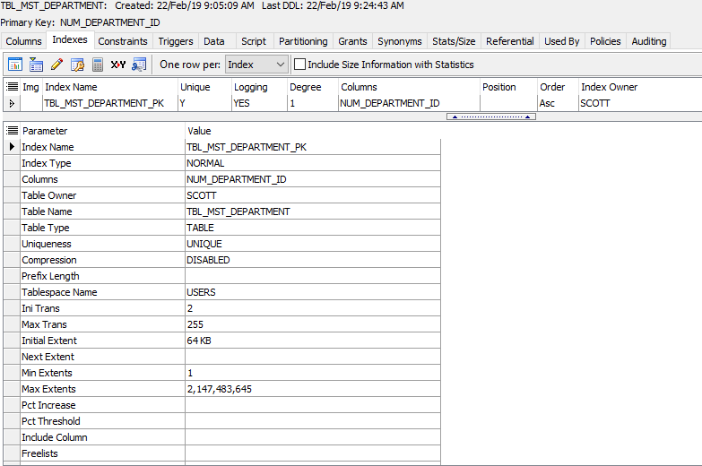
Department

Slide 52
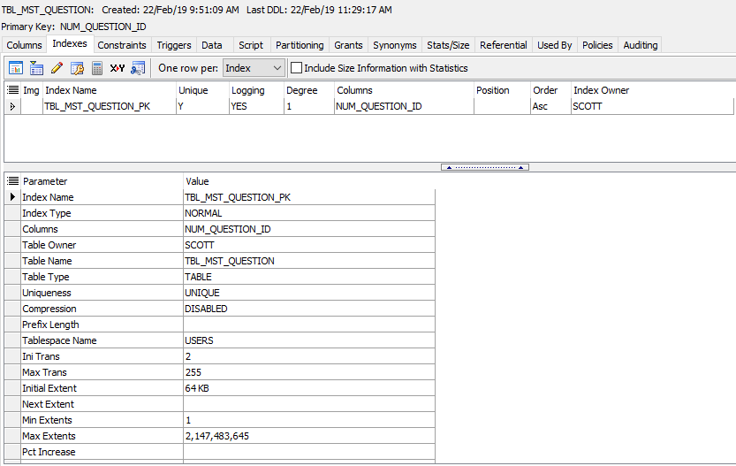
Question

Slide 53
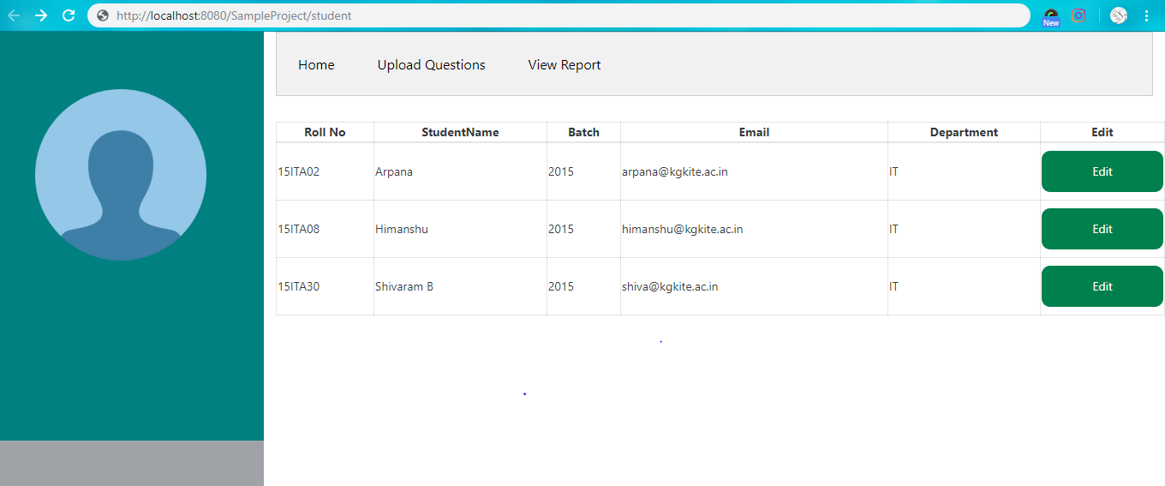
Screenshots for database access(Student Details)

Slide 54
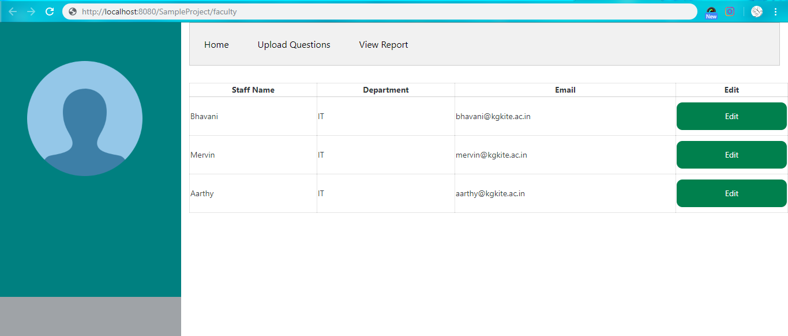
Staff Details

Slide 55
Testing Plans
Unit Testing
Integration Testing
DB Testing

Slide 56
Conclusion
Application will analyse the student score and set a difficulty level. Scores determine the understanding level of the student. Difficulty level increases or decreases based upon their performance. Randomization algorithm would be used to avoid plagiarism.

Slide 57
Questions?

Slide 58
ThankYou

